Slide 1
Memory-Optimized PII Protection System

Slide 2

01
Purpose of Lightweight PII Detection
02
Architecture Overview
Presentation Overview
03
Multilingual Regex Support
04
Arabic Language Enhancements
05
Batch Processing and Final Output

Slide 3

Introduction: Lightweight PII Detection
Need for Memory-Optimized Solutions
In document-heavy environments, lightweight systems reduce infrastructure costs and improve performance without sacrificing security.
Targeted for Documents
Designed for protecting PII in static text files, scanned documents, and digital archives.
Compliance and Efficiency
Helps organizations meet GDPR, HIPAA, and local data protection laws efficiently.

Slide 4
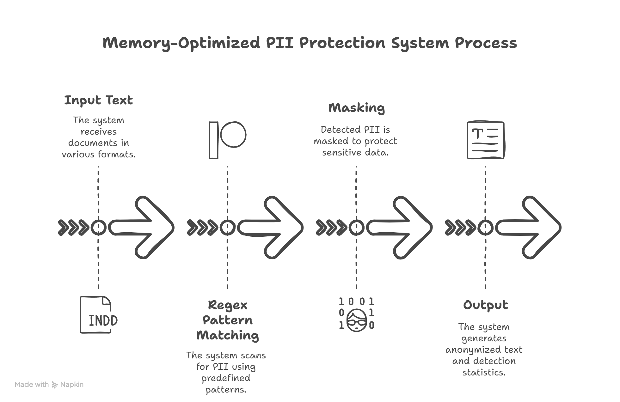

Slide 5

Multilingual Regex Support
English Patterns
Detects US SSN, UK NIN, IP addresses, email formats accurately.
French Patterns
Handles French-specific identifiers like Phone numbers, Postal Codes, SIRET, SIREN, and VAT IDs.
Arabic Patterns
Supports detection of Names, National IDs, Passports, and common Address structures.

Slide 6
Arabic Language Enhancements
Arabic Reshaping
Arabic text reshaping ensures correct visual and logical representation, critical for pattern matching.
Improved Entity Detection
Reshaping improves Regex hits for Arabic names, national IDs, and addresses.
Multilingual Harmony
Ensures Arabic Regex patterns work seamlessly alongside English and French.

Slide 7

Redaction Strategies by Entity Type
Emails and Phones
Emails are replaced with [EMAIL] tags, phones with [PHONE] placeholders while maintaining length hints.
Names and Addresses
Names are partially masked, addresses generalized at the city level.
Dynamic Masking
Customizable redaction templates allow flexibility for compliance or internal policies.

Slide 8

Batch Processing for Scalability
Concurrent Document Processing
Regex matching is highly parallelizable, allowing hundreds of documents to be processed in parallel threads.
Resource Efficiency
Minimal memory footprint enables deployment on low-resource environments like edge servers.
Production Ready
The system can be deployed standalone or integrated into document management platforms.

Slide 9

Final Output and Statistics
Anonymized Text
The final output provides fully masked text while preserving document structure and readability.
Detected Entity List
Complete metadata about detected PII entities (type, text span, pattern used).
Processing Metrics
Statistics like number of detections, processing time, and efficiency reports are generated.

